Slide 1
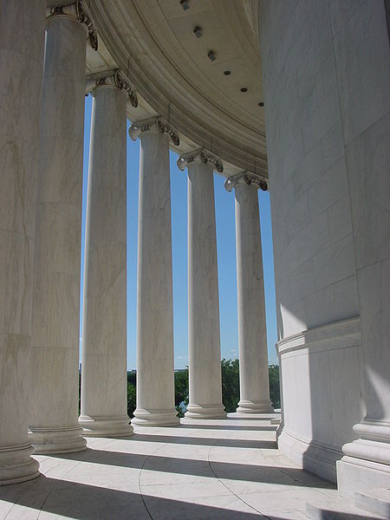
Analytics in Action:
Predicting Wine Quality
July 9, 2013

Slide 2
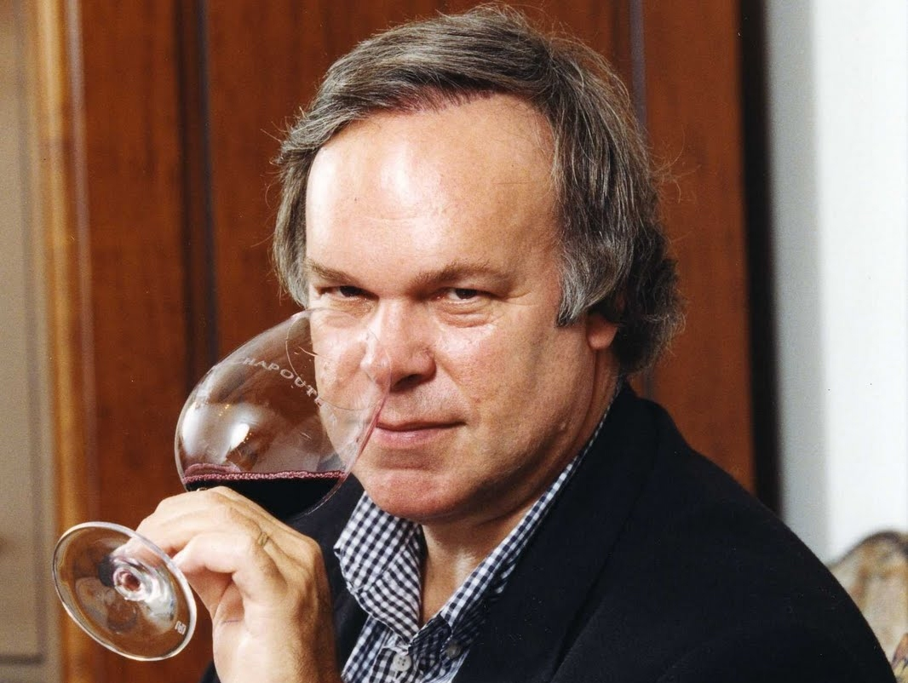
Meet Robert Parker Jr., Wine Guru
Robert Parker is the foremost wine taster worldwide and his subjective 100 point ratings often drive whether a vineyard is successful and if its wines get invited into the best restaurants.

Slide 3
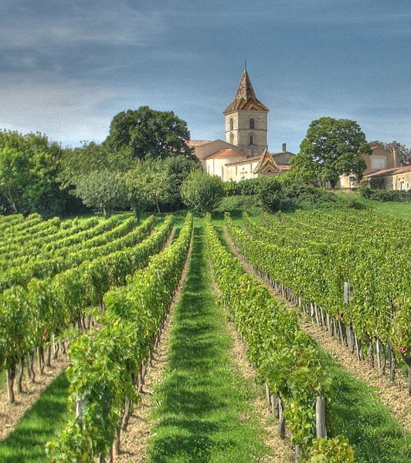
Bordeaux Wine
Large differences in price and quality between years, although wine is produced in a similar way
Meant to be aged, so hard to tell if wine will be good when it is on the market
Expert tasters predict which ones will be good
Can analytics be used to come up with a different system for judging wine?

Slide 4
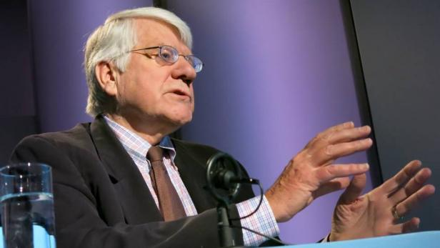
Meet Orley Ashenfelter, Princeton Economist
Orley is a respected economist at Princeton who edited the American Economic Review. He noticed that Bordeaux are best when the grapes are ripe and their juice is concentrated. In years when the summer is hot, grapes get ripe. And, in years of below-average rainfall, the fruit gets concentrated. So it's in the hot and dry years that you tend to get the legendary vintages. Orley believed a predictive model based on weather would help him select the better wines.

Slide 5
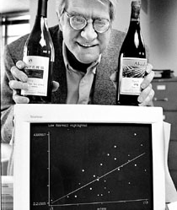
Predicting the Quality of Wine
March 1990 - Orley Ashenfelter, a Princeton economics professor, claims he can predict wine
quality without tasting the wine.

Slide 6
Building a Model
Ashenfelter used a method called linear regression
Predicts an outcome variable, or dependent variable
Predicts using a set of independent variables
Dependent variable: typical price in 1990-1991 wine auctions (approximates quality)
Independent variables:
Age – older wines are more expensive
Weather
Average Growing Season Temperature
Harvest Rain
Winter Rain

Slide 7
The Data (1952 – 1978)
(Logarithm of) Price
8.5
(Logarithm of) Price
8.5
7.5
7.5
6.5
6.5
5
10
15 20 25
Age of Wine (Years)
30
15.0 15.5 16.0 16.5 17.0 17.5
Avg Growing Season Temp (Celsius)
(Logarithm of) Price
8.5
(Logarithm of) Price
8.5
7.5
7.5
6.5
6.5
50
100 150 200 250 300
Harvest Rain (mm)
400
500 600 700
Winter Rain (mm)
800

Slide 8
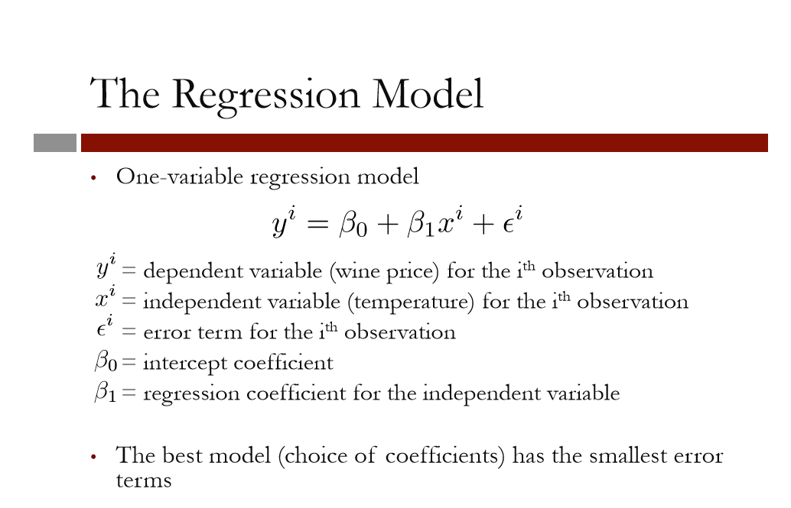

Slide 9
Compares the best model to a “baseline” model
_{R}2
8.5
8.0
(Logarithm of) Price
The baseline model does not use any variables
Predicts same outcome (price) regardless of the independent variable (temperature)
7.5
7.0
6.5
15.0
15.5 16.0 16.5 17.0 17.5
Avg Growing Season Temp (Celsius)

Slide 10
SSE = 5.73
SST = 10.15
_{R}2
8.5
8.0
(Logarithm of) Price
7.5
7.0
6.5
15.0
15.5 16.0 16.5 17.0 17.5
Avg Growing Season Temp (Celsius)

Slide 11
Interpreting R²
R² = 1 — ^{SSE}
SST
captures value added from using a model
_{R}2
•
•
_{R}2
= 0 means no improvement over baseline
R² = 1 means a perfect predictive model
Unitless and universally interpretable
Can still be hard to compare between problems
Good models for easy problems will have R² ≈ 1
Good models for hard problems can still have R² ≈ 0

Slide 12
Available Independent Variables
So far, we have only used the Average Growing Season Temperature to predict wine prices
Many different independent variables could be used
Average Growing Season Temperature
Harvest Rain
Winter Rain
Age of Wine (in 1990)
Population of France

Slide 13
Multiple Linear Regression
Using each variable on its own:
R² = 0.44 using Average Growing Season Temperature
R² = 0.32 using Harvest Rain
R² = 0.22 using France Population
R² = 0.20 using Age
R² = 0.02 using Winter Rain
Multiple linear regression allows us to use all of these variables to improve our predictive ability

Slide 14
Adding Variables
Variables | _{R}2
Average Growing Season Temperature (AGST) | 0.44
AGST, Harvest Rain | 0.71
AGST, Harvest Rain, Age | 0.79
AGST, Harvest Rain, Age, Winter Rain | 0.83
AGST, Harvest Rain, Age, Winter Rain, Population | 0.83
Adding more variables can improve the model
Diminishing returns as more variables are added

Slide 15
Selecting Variables
Not all available variables should be used
Each new variable requires more data
Causes overfitting: high R² on data used to create model, but bad performance on unseen data
We will see later how to appropriately choose variables to remove

Slide 16

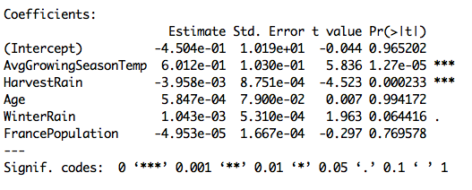
Understanding the Model and Coefficients
1

Slide 17
Correlation
A measure of the linear relationship between variables
+1 = perfect positive linear relationship
0 = no linear relationship
-1 = perfect negative linear relationship
1

Slide 18
Examples of Correlation
8.5
8.0
(Logarithm of) Price
7.5
7.0
6.5
400
500 600
700
800
Winter Rain (mm)

Slide 19
Examples of Correlation
Avg Growing Season Temp (Celsius)
17.5
17.0
16.5
16.0
15.5
15.0
50
100 150 200
Harvest Rain (mm)
250
300

Slide 20
Examples of Correlation
Population of France (thousands)
52000
48000
44000
5
10
15 20
Age of Wine (Years)
25
30

Slide 21
Predictive Ability
Our wine model had a value of R² = 0.83
Tells us our accuracy on the data that we used to build the model
But how well does the model perform on new data?
Bordeaux wine buyers profit from being able to predict the quality of a wine years before it matures

Slide 22
Out-of-Sample R²
Variables |  |  |  | Model _{R}2 | Test _{R}2
AGST |  |  |  | 0.44 | 0.79
AGST, | Harvest Rain |  |  | 0.71 | -0.08
AGST, | Harvest Rain, | Age |  | 0.79 | 0.53
AGST, | Harvest Rain, | Age, | Winter Rain | 0.83 | 0.79
AGST, | Harvest Rain, | Age, | Winter Rain, Population | 0.83 | 0.76
Better model R² does not necessarily mean better test set R²
Need more data to be conclusive
Out-of-sample R² can be negative!

Slide 23
The Results
Parker:
1986 is “very good to sometimes exceptional”
Ashenfelter:
1986 is mediocre
1989 will be “the wine of the century” and 1990 will be even better!
In wine auctions,
1989 sold for more than twice the price of 1986
1990 sold for even higher prices!
Later, Ashenfelter predicted 2000 and 2003 would be great
Parker has stated that “2000 is the greatest vintage Bordeaux has ever produced”

Slide 24
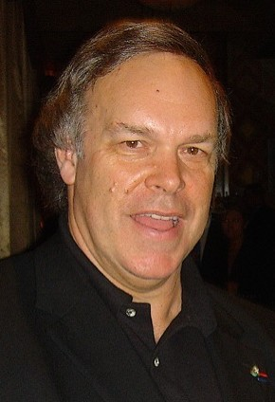
The Expert’s Reaction
Robert Parker, the world's most influential wine expert:
“Ashenfelter is an absolute total sham”
“rather like a movie critic who never goes to see the movie but tells you how good it is based on the actors and the director”

Slide 25
The Analytics Edge
A linear regression model with only a few variables can predict wine prices well
In many cases, outperforms wine experts’ opinions
A quantitative approach to a traditionally qualitative problem

